Slide 1

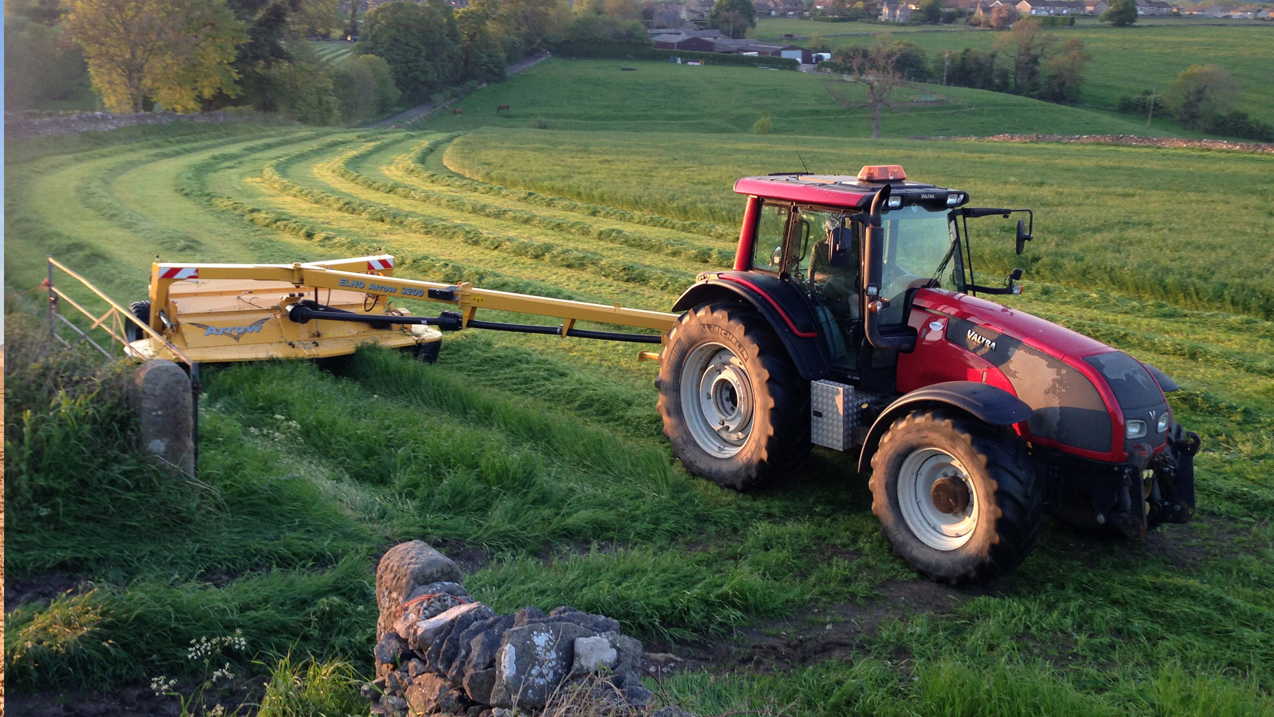
Project Presentation (KCS 851)
Guide: Prof. Shivani
Members:
Aman Raj Singh | 2100290129003 | CS 7A
Govind Singh | 2000290120066 | CS 7A

Slide 2

Problem Statement
The challenge is to create an affordable farm equipment sharing platform that addresses the pressing need for cost-effective access to agricultural machinery among small and medium-sized farmers, fostering increased productivity and sustainability in agriculture.

Slide 3

Objectives
To create an accessible, web-based platform that connects farmers seeking specific types of farm equipment with equipment owners who are willing to share or rent their machinery.
To substantially reduce the financial burden on small and medium-sized farmers by enabling them to access required farm equipment at a fraction of the cost of ownership.
To enhance the efficiency and utilization of farm equipment by implementing intelligent scheduling and resource allocation algorithms that minimize downtime.

Slide 4
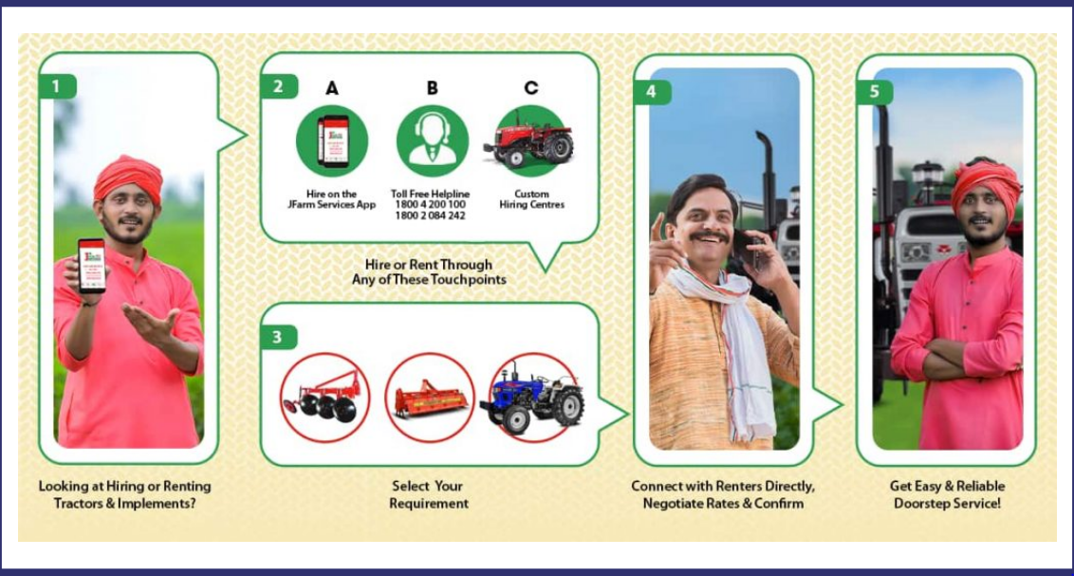

Slide 5
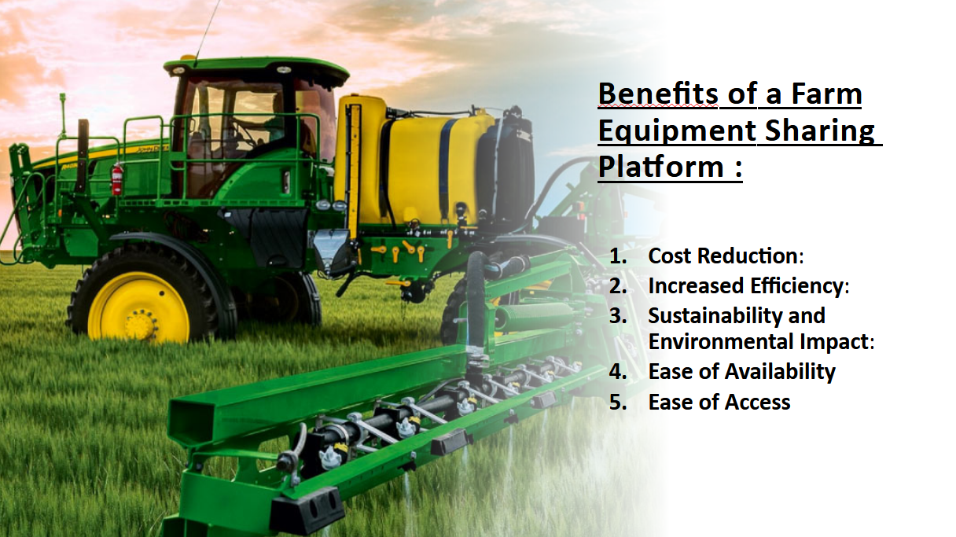

Slide 6


Technology Used
HTML
CSS
JavaScript
Bootstrap
Python
Flask
MySQL

Slide 7
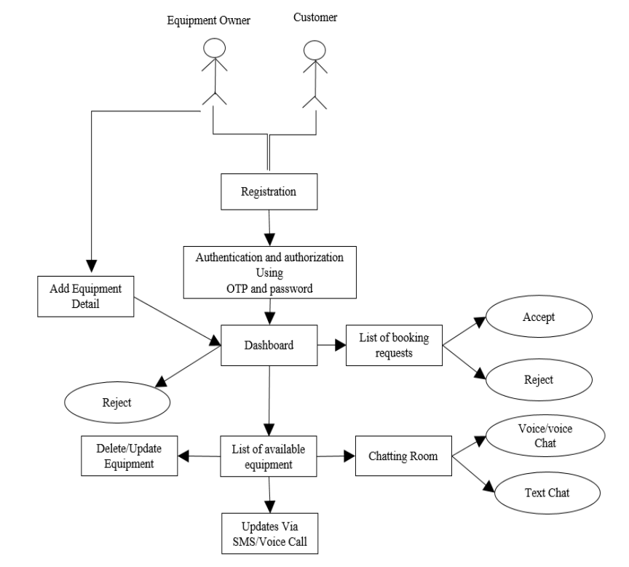
Workflow Diagram

Slide 8
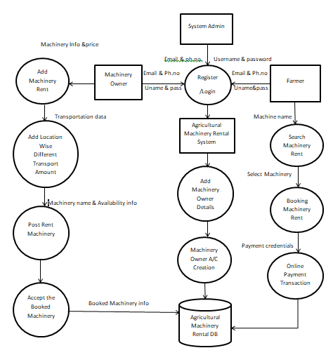
Data Flow Diagram (DFD)

Slide 9
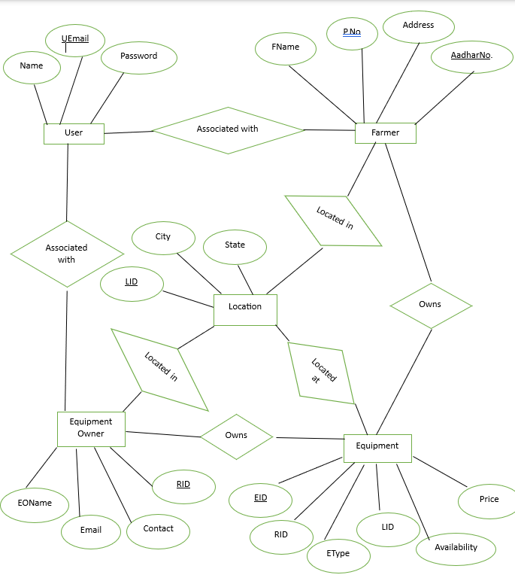
ER Diagram

Slide 10
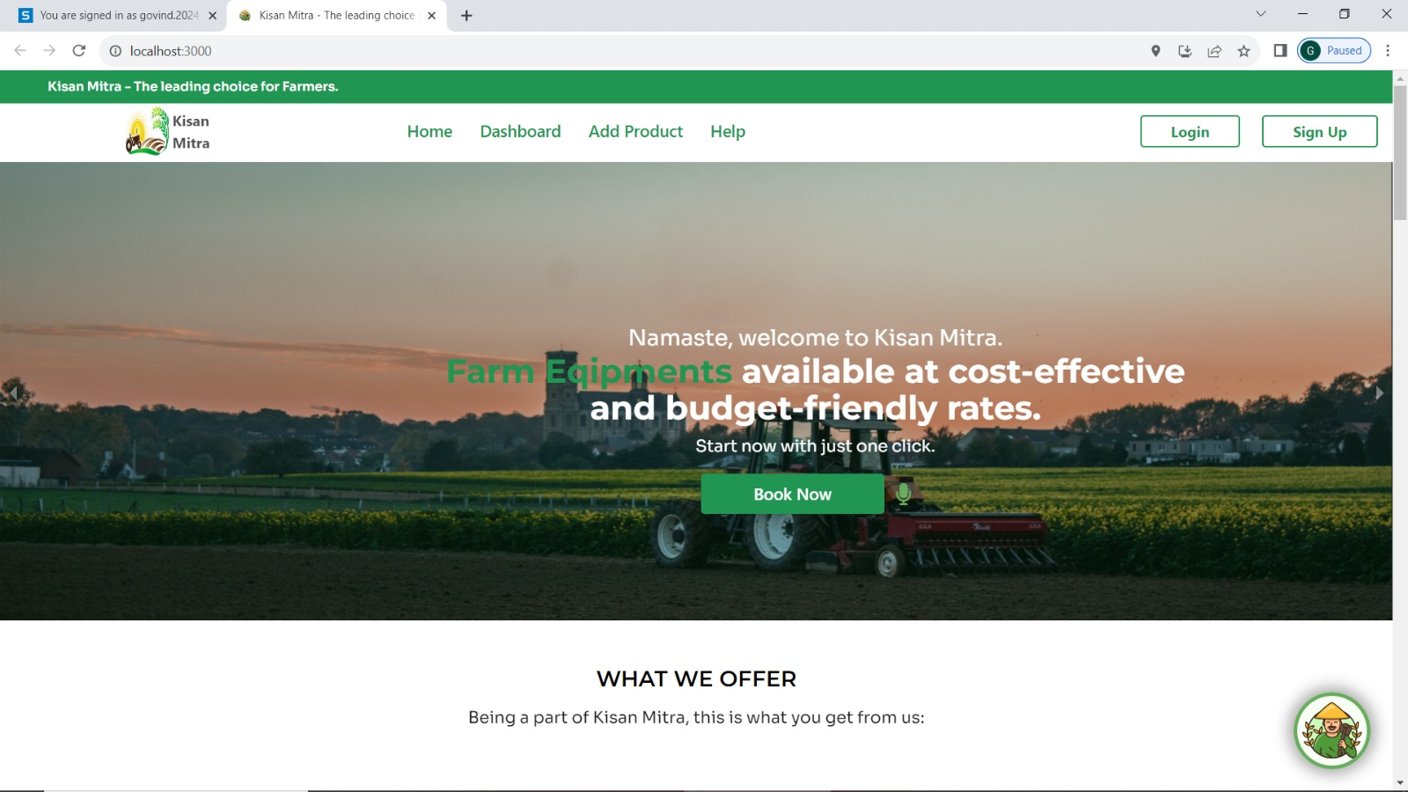
Project Status : 100%

Slide 11
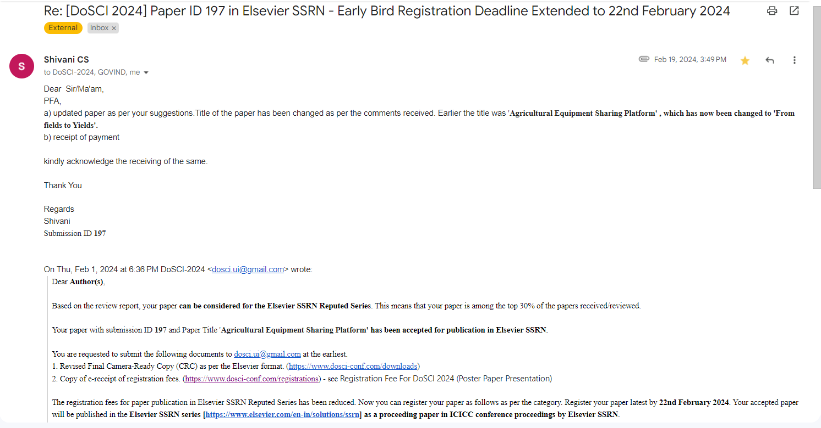
Research Paper Status : 100% completed And Submitted

Slide 12
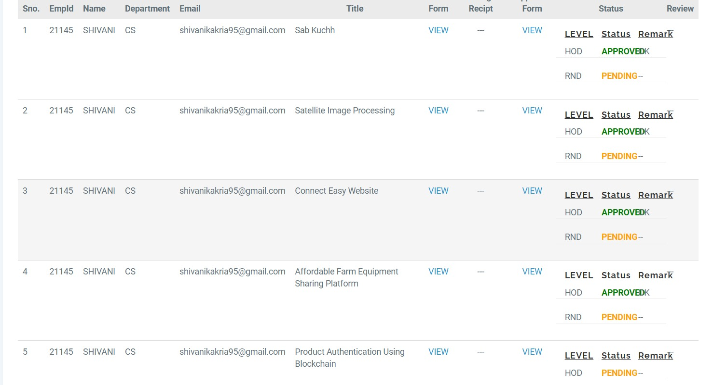
Patent Status : Through KIET

Slide 13
References
Smith, J., & Brown, A. (Year). "Empowering Small-scale Farmers: A Case Study of Affordable Farm Equipment Sharing Platforms." Journal of Agricultural Innovation, vol. 10, no. 2, pp. 123-135.
Garcia, L., & Nguyen, T. (Year). "Community Building Through Affordable Farm Equipment Sharing: A Social Impact Analysis." International Journal of Rural Development, vol. 15, no. 4, pp. 367-378.
Martinez, K., & Lee, S. (Year). "Economic Viability of Affordable Farm Equipment Sharing Platforms: A Comparative Analysis." Agricultural Economics Review, vol. 22, no. 3, pp. 289-302.
Wang, Q., & Chen, H. (Year). "Overcoming Challenges in Implementing Farm Equipment Sharing Platforms: Insights from a Pilot Study." Journal of Agricultural Engineering Research, vol. 45, no. 1, pp. 56-68.
5. Johnson, R., & Green, M. (Year). "Blockchain Technology in Agricultural Resource Sharing: A Case Study of Affordable Farm Equipment Platforms." International Journal of Sustainable Development & World Ecology, vol. 28, no. 2, pp. 178-191.
6. Anderson, P., et al. (Year). "Collaborative Consumption and Sustainable Agriculture: Exploring the Environmental Impacts of Affordable Farm Equipment Sharing Platforms." Sustainability Science, vol. 12, no. 5, pp. 789-802.

